Slide 1
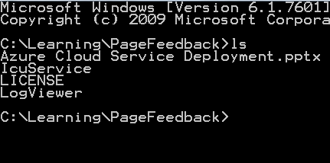
Deploy Azure cloud service with commandline NAnt, PowerShell
Theeranip Pongtongmuang MCT, MCPD VP of Engineering Noonswoon Co.,Ltd

Slide 2
Deploying Azure website Deploying Azure cloud Service with Visual studio Deploying Azure cloud service with command line
Agenda

Slide 3
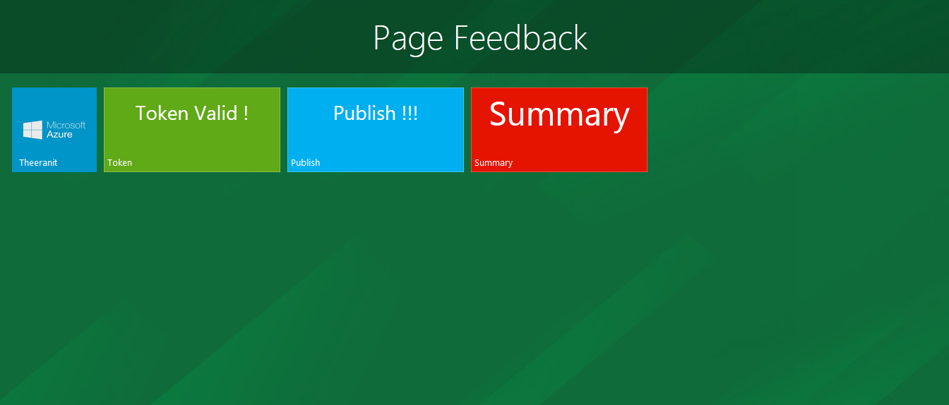
Our Finishing Project ( FB Page Feedback)

Slide 4
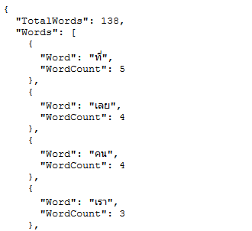
Words split return

Slide 5

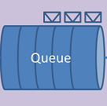
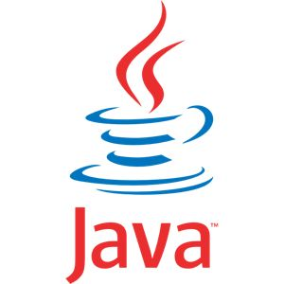


Architecture
Facebook
Graph API
Public FB
Page data
WebRole
WorkerRole
WebSite
Azure environment

Slide 6
Focus on your App not infrastructure

Slide 7
What if without Azure cloud service
Create web project
Create windows service, or exe , console app command line app for query FB data and called split API
Set up Virtual Machine (Linux or Windows)
Deploy web project
Deploy background app project
Setup message queue server (Ex RabbitMQ, ActiveMQ)
Setup Database Server (MS SQL Server, MySQL)

Slide 8
Main benefit from cloud
Managed system, don’t need to maintain server
Focus on your app and a little knowledge on deployment
Build complex application, log running task process
Multitier application ( web role, worker role)
Access unmanaged code( C, C++)
Install any custom MSI
Run exe
Remote desktop access to servers

Slide 9
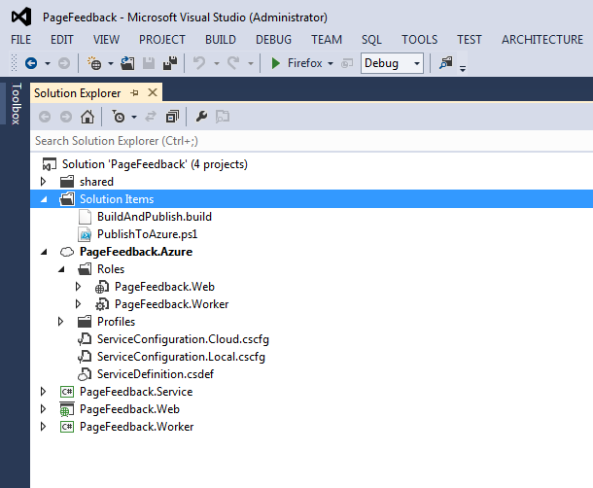
.NET Azure Cloud Service Project

Slide 10
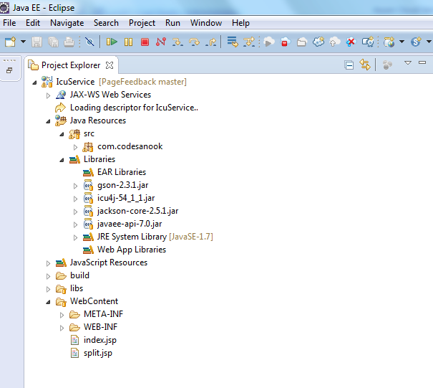
Java REST API Service

Slide 11
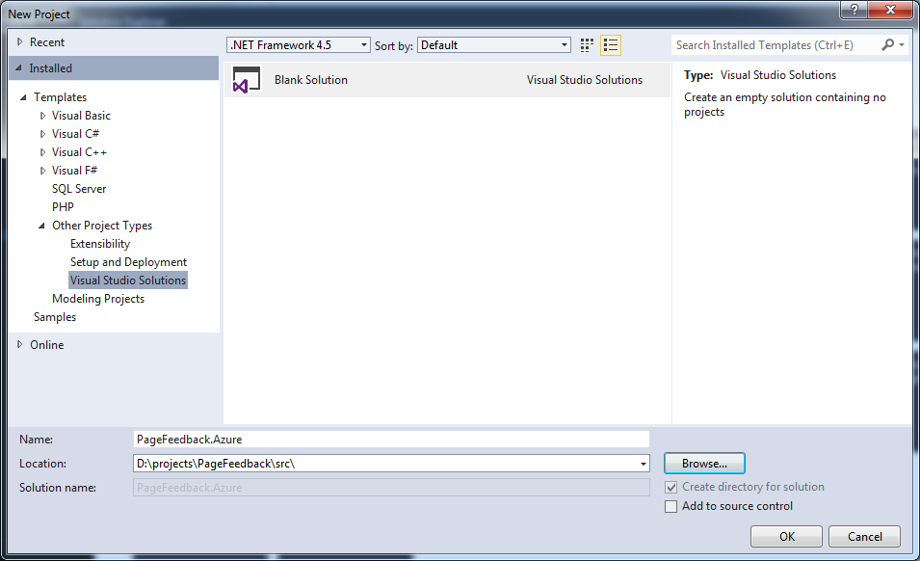
Setup project

Slide 12
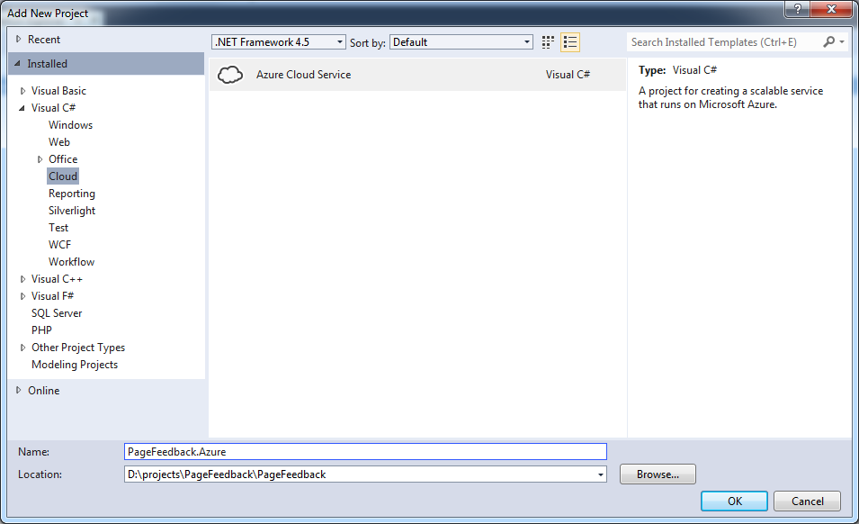
Setup project

Slide 13
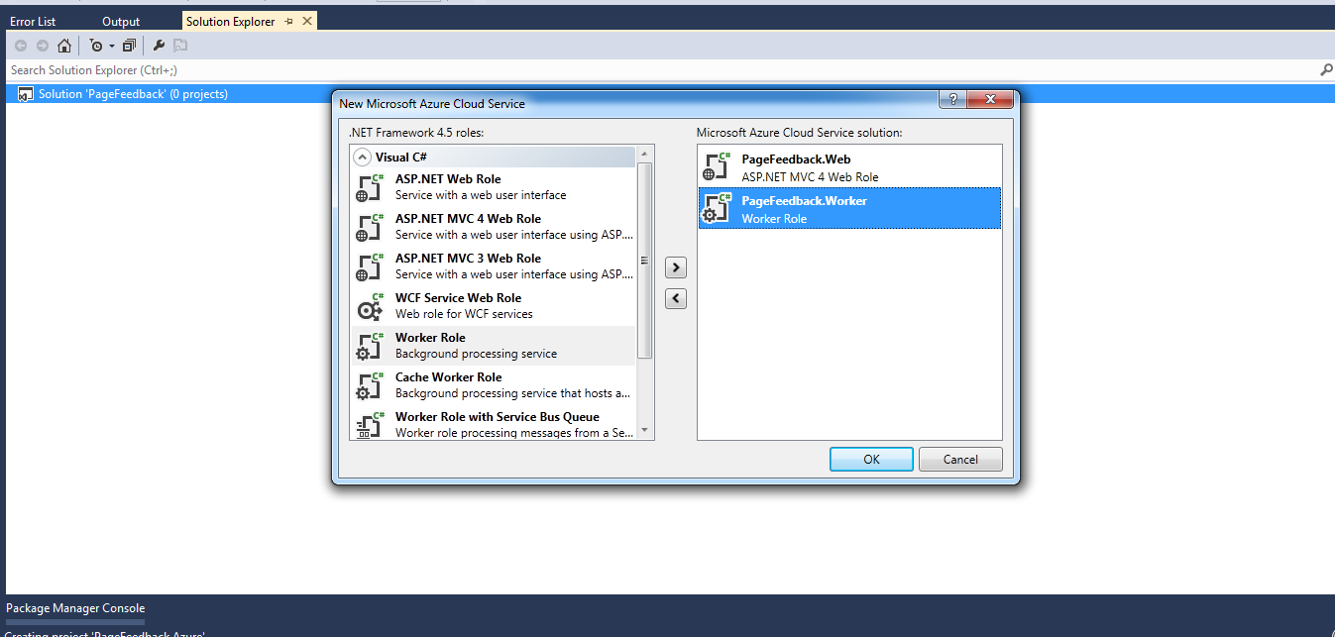
Setup project

Slide 14
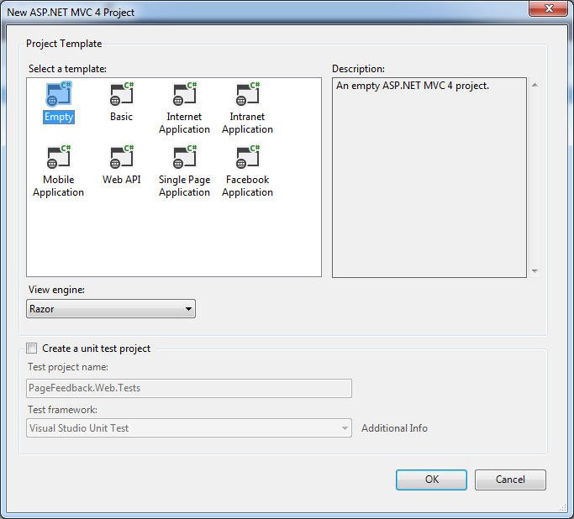
Setup project

Slide 15
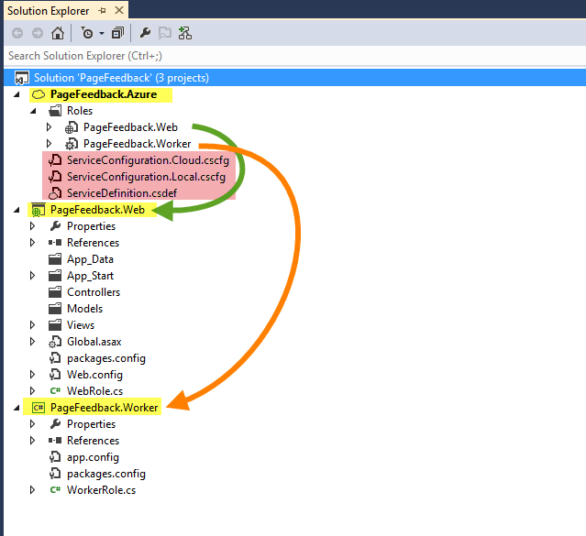
Project structure
Azure cloud service project (PageFeedback.Azure)
Web role project (PageFeedback.Web) => website (usually one per cloud service)
Worker role project (PageFeedback.Worker) => background worker (multiple)

Slide 16
Azure cloud service project (PageFeedback.Azure)
Manage all associated worker roles in solution
Startup project for Azure cloud service project
Container for multiple web roles and worker roles
Contains cloud service configuration file (share to all roles)
ServiceDefinition.csdef (define all configurations)
ServiceConfiguration.Cloud.cscfg ( set configuration values for release environment)
ServiceConfiguration.Local.cscfg (set configuration values for local development)

Slide 17
Web Role Project
Can be any ASP.NET web project (ASP.NET MVC or WebForm)
Only reference with Azure SDK library
Contain base class of RoleEntryPoint (WebRole.cs) as entry point of WebRole, work as controller of machine that web role stay on
Main purpose for web application, request, response, WEB API

Slide 18
Worker Role Project
Just .NET class library project
Only reference with Azure SDK library
Contain base class of RoleEntryPoint (WorkerRole.cs) as entry point of WorkerRole, work as controller of machine that worker role stay on

Slide 19
RoleEntryPoint.cs
3 main method to override
OnStart
Initialize application
Must return true
Run
Working code, in while loop
if it return role will be stop and restart
OnStop
Called when role stop, clear running process, stop consuming message from queue

Slide 20
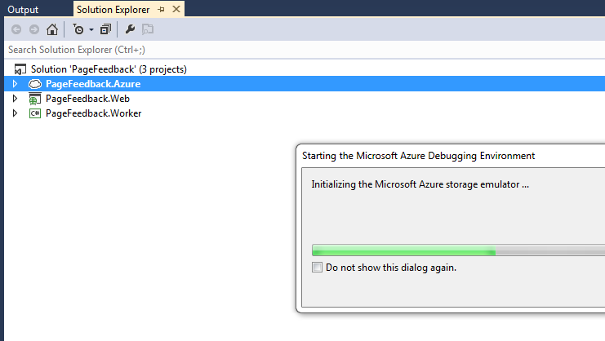
Run Azure cloud project
in Emulator
DEMO

Slide 21
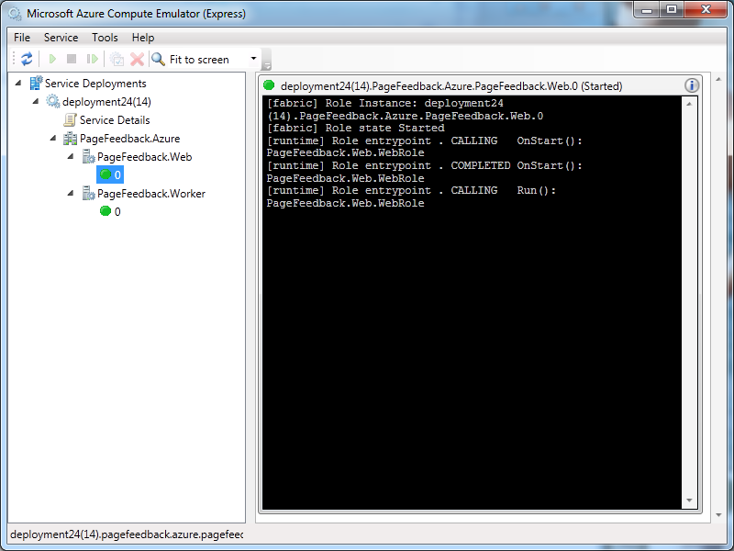
Emulator monitor

Slide 22
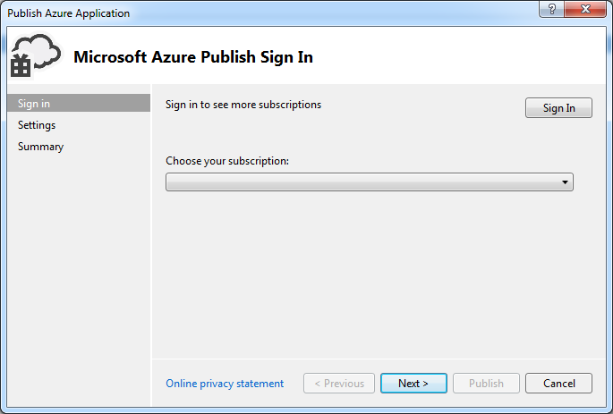
Deploy with Visual Studio

Slide 23
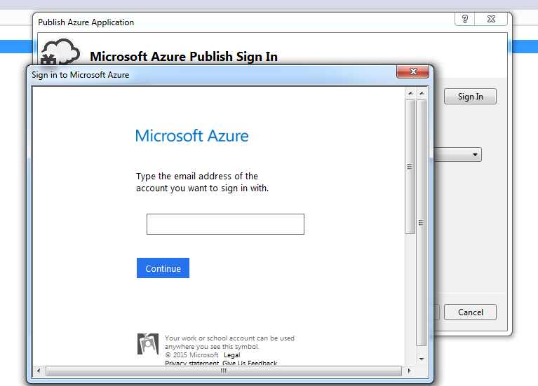
Log In with Azure Account

Slide 24
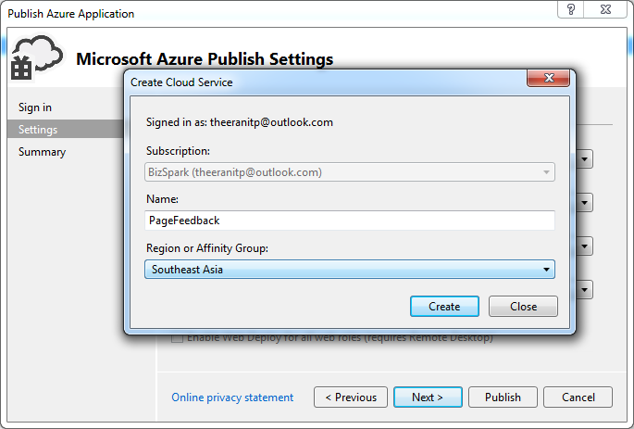
Configure cloud service

Slide 25
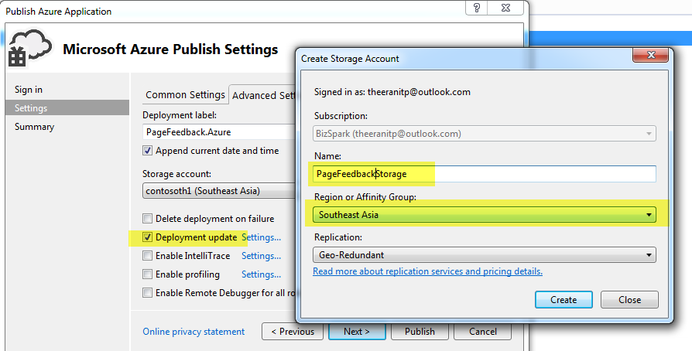
Configure cloud service continous

Slide 26
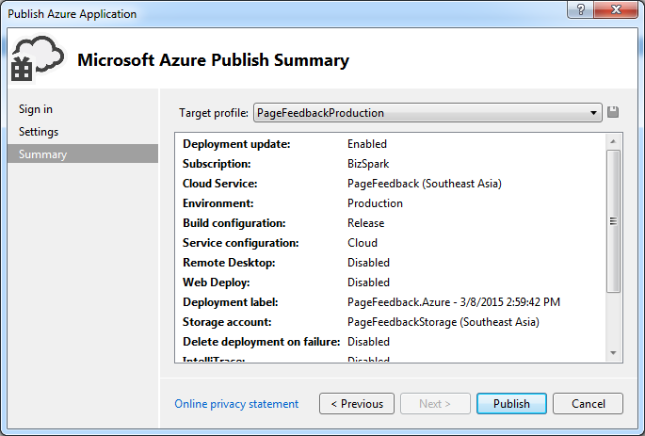
Publish

Slide 27
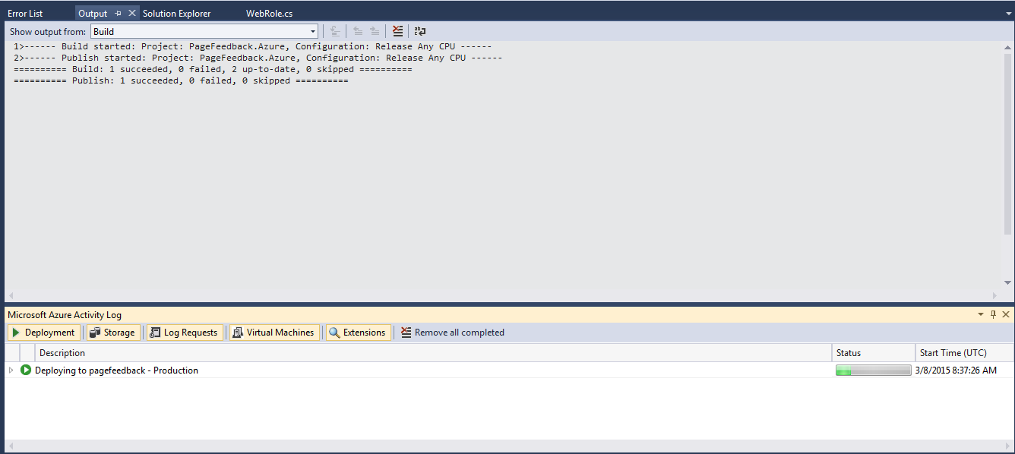
Setup project

Slide 28
Deploy Azure with Command Line Tool
Benefit
Integrated with build server (Jenkins , Cruise control)
Fast to deploy with Git ( git push origin master)

Slide 29
Deploy Azure with Command Line Tool
File to setup Azure PowerShell

Slide 30
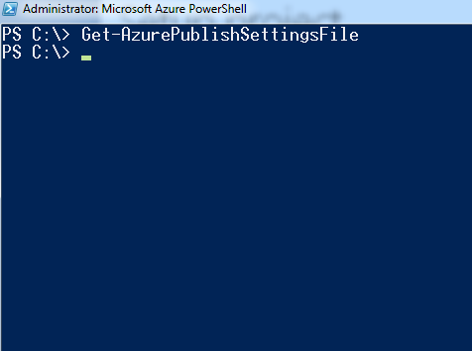
Setup project
> Get-AzurePublishSettingsFile
> Set-ExecutionPolicy Unrestricted -Force

Slide 31
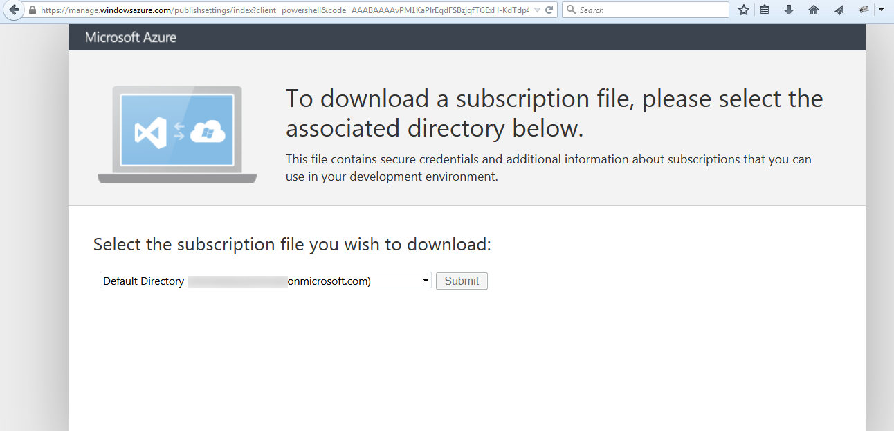
Install Azure PowerShell

Slide 32
NAnt Project
<project>
<target>
<task>
Msbuild
PowerShell command line exe

Slide 33
Scale VM Size and Instance count
Change cloud configuration

Slide 34
Summary

Slide 35
Summary

